Slide 1
MUX in Golang

Slide 2
Agenda
Introduction

Slide 3
Introduction
Create routes with named parameters, GET/POST handlers and domain
gorrill/mux is a package which adapts to Go’s default HTTP router
func (w http.ResponseWriter, r *http.Request)

Slide 4
Installing the gorill/mux package
Go get –u github.com/gorilla/mux

Slide 5
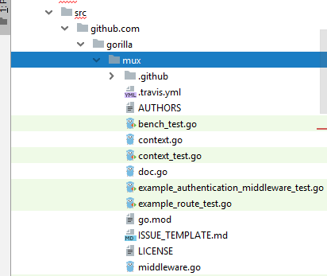

Slide 6
Creating a new Router
r := mux.NewRouter()
It will receive all HTTP connections and pass it on to the request handlers you will register on it

Slide 7
Example simple
func main() { r := mux.NewRouter() r.HandleFunc("/", HomeHandler) r.HandleFunc("/products", ProductsHandler) r.HandleFunc("/articles", ArticlesHandler) http.Handle("/", r) }

Slide 8
Regular expression pattern
r := mux.NewRouter() r.HandleFunc("/products/{key}", ProductHandler) r.HandleFunc("/articles/{category}/", ArticlesCategoryHandler) r.HandleFunc("/articles/{category}/{id:[0-9]+}", ArticleHandler)

Slide 9
r := mux.NewRouter() // Only matches if domain is "www.example.com". r.Host("www.example.com") // Matches a dynamic subdomain. r.Host("{subdomain:[a-z]+}.domain.com")

Slide 10
header values
There are several other matchers that can be added. To match path prefixes:
r.PathPrefix("/products/")
HTTP methods:
r.Methods("GET", "POST")
URL schemes:
r.Schemes("https")
Header values
r.Headers("X-Requested-With",XMLHttpRequest")
Query values:
r.Queries("key", "value")

Slide 11
Combine several matchers
r.HandleFunc("/products", ProductsHandler).
Host("www.example.com").
Methods("GET").
Schemes("http")

Slide 12
Middleware
type MiddlewareFunc func(http.Handler) http.Handler
func simpleMw(next http.Handler) http.Handler {
return http.HandlerFunc(func(w http.ResponseWriter, r *http.Request) {
// Do stuff here
log.Println(r.RequestURI)
// Call the next handler, which can be another middleware in the chain, or the final handler.
next.ServeHTTP(w, r)
})
}

